Slide 1
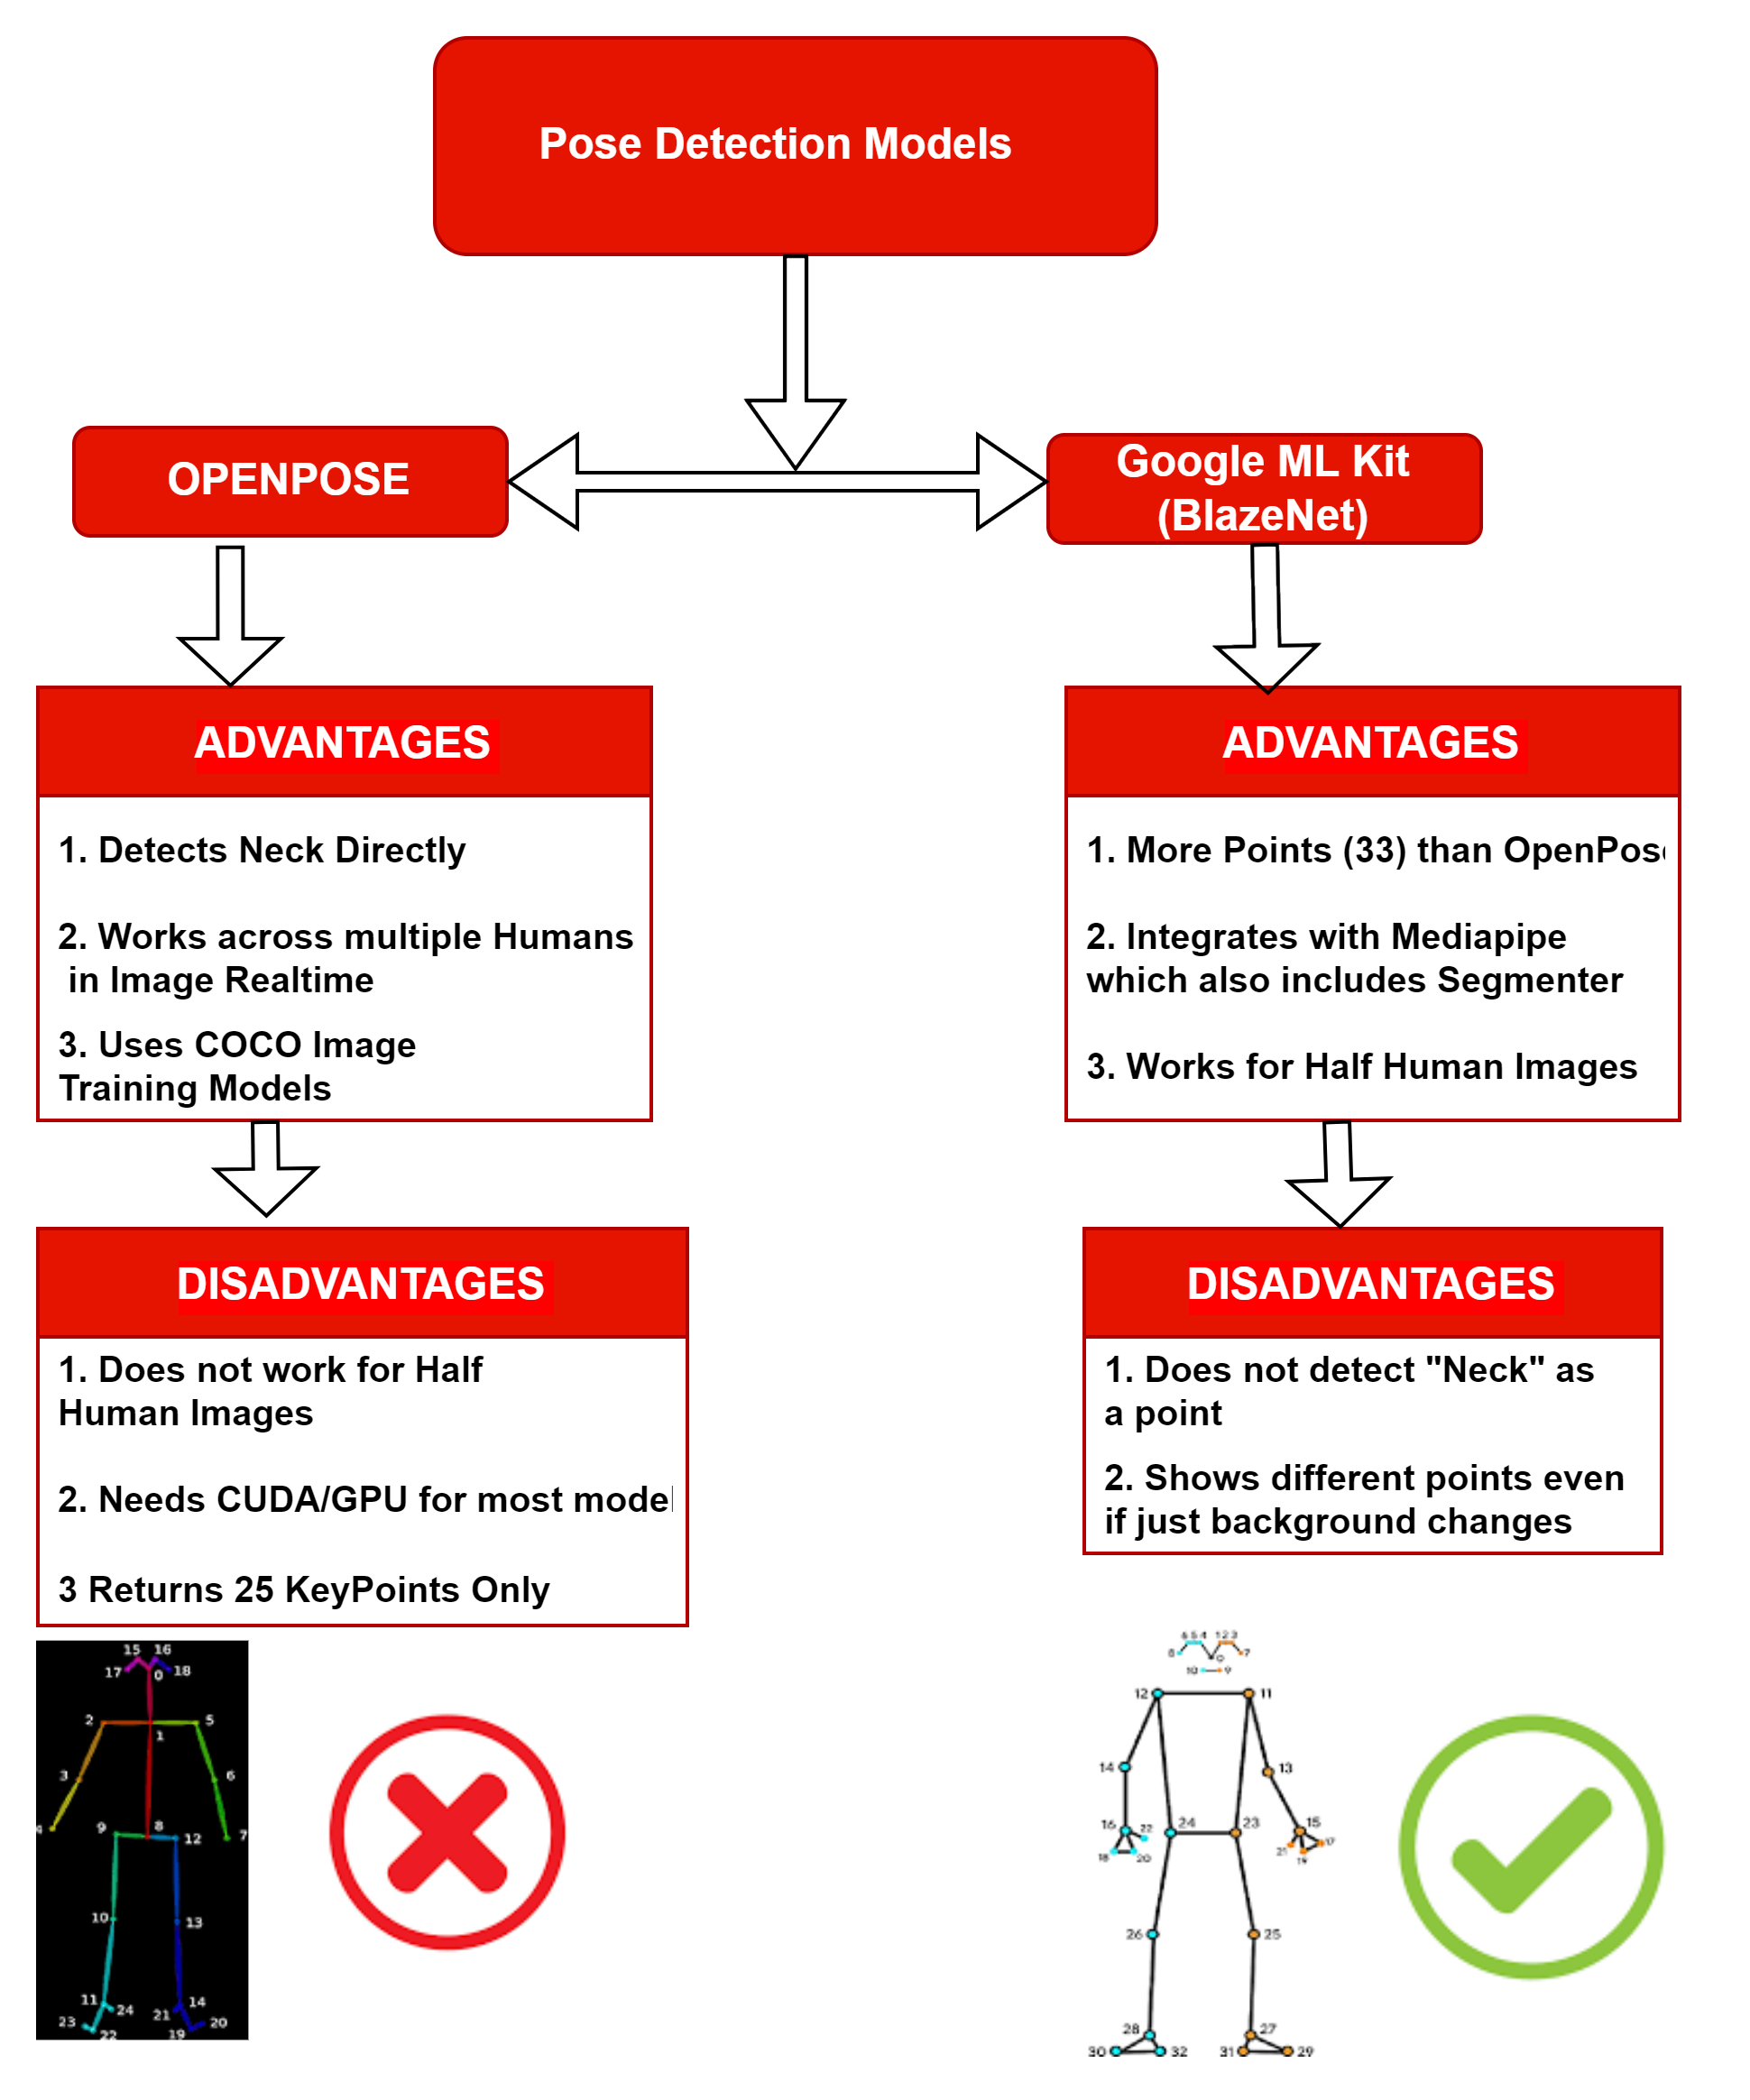
Virtual Try On Solutions- Necklace
Problem statement
Necklace Virtual Try On cannot be done using Face Detection or Face Segmentation Mechanisms.
In order to position a Necklace on a Human Image, we need to be able to determine the “thorax” and the relative Pose orientation of the Human Image to be able to accurately wrap and place the Necklace
OpenPose and BlazePose(via BlazeNet/MediaPipe) are 2 possible ML Models providing Solutions to the above Problem as they help detect or compute relative Pose Orientation Points
BlazePose(MediaPipe) has been chosen for this specific implementation as it allows us to suitably implement the same on “Selfie Images”

Slide 2
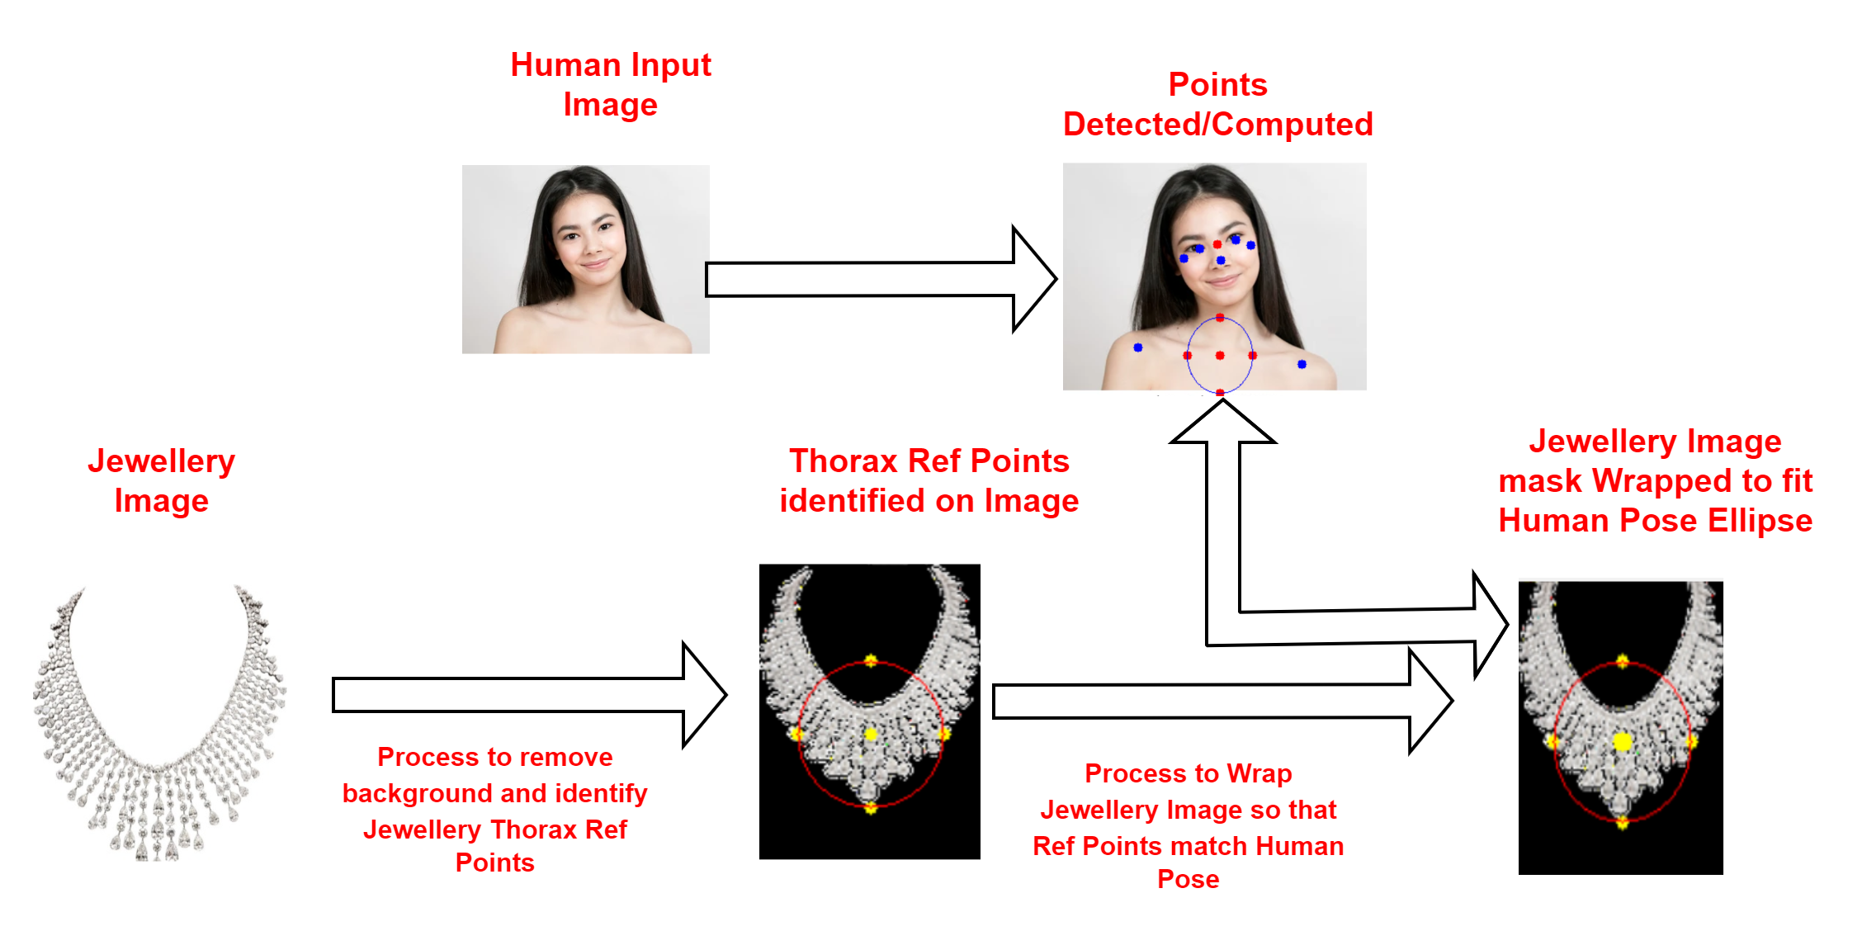
Virtual Try On – Necklace – Jewellery Image Processing
Necklace Image preparation
The Jewelry Image should clearly articulate relative thorax positioning points in the catalog image
Yellow Points below highlight the “Thorax Reference Points” as marked for the Jewelry Image.
Jewelry Image needs to be resized and wrapped to overlay on Human image
Thorax Relative Ref points are available along with Jewelry Image (yellow points in image below)

Slide 3
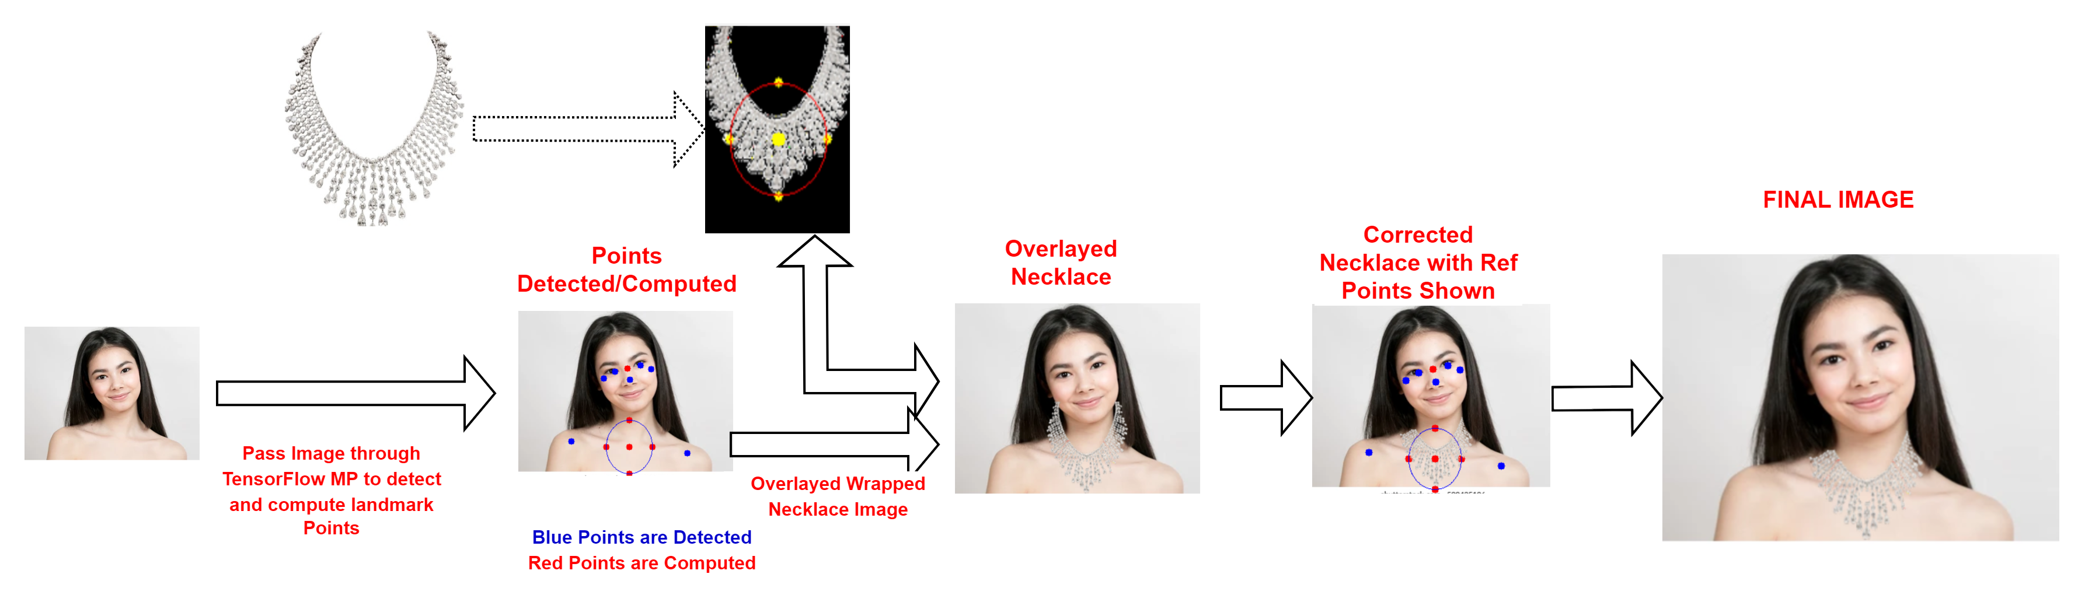
Virtual Try On – Necklace – Human Image Processing
HUMAN Image PROCESSING
Human Image Landmark Points for Necklace Overlay are detected via TF(BlazePose)
BLUE points are detected – RED are computed
Necklace Image is wrapped to fit on Human Reference Points (Yellow Points over Red Points)
Any outgrowth of the Necklace overlay is removed via Selfie Segmentation to regenerate the Face skin, Hair and Earrings

